Slide 1


Azure Service Adoption and Customer Migration Study
C+E Analytics and Insights
May, 2015

Slide 2
Agenda
Azure Behavioral segmentation
Growth levers for Azure:
Growing AURPC - Migration
Growing AURPC - PaaS vs. IaaS adoption
Growing AURPC - Service affinity
AWS Compete
Impacting CE teams
Next steps

Slide 3
This study has identified three growth levers for Azure
Increase customer acquisition
Grow average utilized revenue (AURPC)
Reduce churn

Slide 4








Behavioral Clusters: Summary
Deeply Engaged
Potentials
Evaluators
Dabblers
Disengaged
# Services: 7
Normalized Usage: 440
Utilized Revenue: $207
% Billable Users: 89%
48% PAYG Customers
44% IaaS Users
# Services: 3
Normalized Usage: 59
Utilized Revenue: $18
% Billable Users: 100%
75% PAYG Customers
35% IaaS Users
# Services: 4
Normalized Usage: 72
Utilized Revenue: 0
% Billable Users: 4%
90% BP Customers
62% IaaS Users
# Services: 3
Normalized Usage: 23
Utilized Revenue: 0
% Billable Users: 29%
60% BP Customers
36% SQL DB Users
# Services: 1
Normalized Usage: 5
Utilized Revenue: 0
% Billable Users: 1%
94% BP Customers
52% Storage Users
NU – Contribution to Azure Normalized usage UR – Contribution to Azure Utilized revenue Pop - Contribution to Azure Population

Slide 5
Revenue skew is significant even within Deeply Engaged
 | Alpha | Beta | Gamma | Omega
% of Deeply Engaged | 28% | 12% | 18% | 41%
% of revenue | 95% | 3% | 2% | 0%
Normalized Usage | 3,686 | 786 | 335 | 147
# of Services | 8 | 7 | 6 | 7
Utilized Revenue | $2,621 | $584 | $217 | $0
# of Projects | 33 | 14 | 9 | 7
Sub-clustering Deeply Engaged customers indicated additional skewness with 95% of revenue coming from Alpha users (28% of Deeply Engaged)
At an all-up level, 2% of all active Azure customers generate 73% of utilized revenue

Slide 6
Key Findings
Skewed Revenue
99% of the revenue is generated by Deeply Engaged and Potentials, who constitute 33% of the population
Top 2% of customers delivered over 73% of revenue on Azure!
Growing AURPC through Customer Migration
The most valuable upgrade path is to Deeply Engaged cluster
The most likely path to Deeply Engaged is from Potentials cluster
Growing AURPC through Cross-sell, PaaS and IaaS Adoption
Selling Virtual Network to customers using Virtual Machines results in a gain of 80 NU* per customer
The best opportunity for up-sell and cross-sell of Premium SKUs is to Deeply Engaged
Deeply Engaged customers use both PaaS and IaaS intensively, resulting in the highest AURPC
Decreasing Churn
2% of customers churned out of the Deeply Engaged cluster, and 8% churned out of Potentials after 3 months
1% churn from the Deeply Engaged cluster represents $351,362 of lost revenue per year!
Winning against Amazon Web Services
To overtake AWS by 2020, we need to increase our CAGR to 89%, versus expected 5 year CAGR of 82% for utilized revenue
A balanced approach based on acquisition, AURPC and churn is required

Slide 7
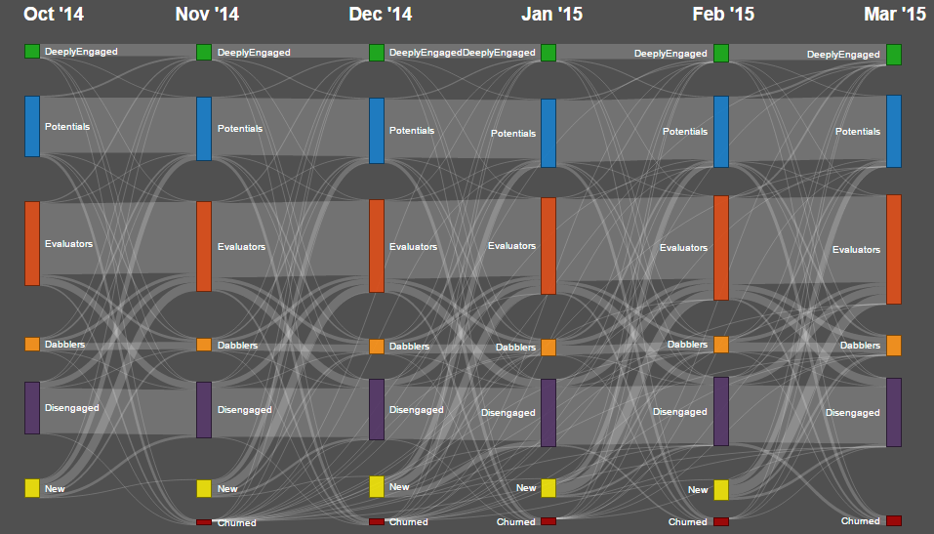
Growing AURPC through Customer Migration
March
 | Deeply Engaged | Potentials | Evaluators | Dabblers | Disengaged | Churned
Deeply Engaged | 84% | 8% | 5% | 2% | 0% | 2%
Potentials | 4% | 84% | 1% | 3% | 0% | 8%
Evaluators | 2% | 1% | 79% | 5% | 10% | 3%
Dabblers | 3% | 12% | 27% | 49% | 5% | 5%
Disengaged | 0% | 0% | 14% | 1% | 78% | 6%
New | 3% | 25% | 45% | 11% | 16% | -
January
3 month migration across Clusters
Deeply Engaged (DE) mostly drop to Potentials (8%) in 3 months
4% of Potentials upgrade to DE (highest contributor). Highest churn was also observed in Potentials (8%)
There is significant back and forth transitions between Evaluators (10%) and Disengaged (14%)
Dabblers have least retention rate (49%) and either upgrade to Evaluators (27%) or Potentials (12%)
Most of new customers become Evaluators (45%) followed by Potentials (25%) and Disengaged (16%)
Dabblers show a natural tendency to upgrade to Potentials and can be further monetized by selling Premium Services
BACK

Slide 8
Growing AURPC through PaaS and IaaS Adoption
IaaS GA
IaaS GA
PaaS usage/revenue is driven by Legacy PaaS customers
In contrast IaaS usage/revenue is driven by new users
Since its introduction, IaaS has replaced PaaS as the main adopted service and primary contributor to Azure Compute revenue and usage
IaaS+PaaS users generate more revenue from IaaS than PaaS
Average utilized revenue per customer is highest for customers who use both IaaS and PaaS
 | AURPC | Legacy | New | # of Accounts | Legacy | New
Iaas only | $153 |  |  | 123,086 |  | 123,086
Paas only | $108 | $160 | $70 | 18,370 | 7,694 | 10,676
IaaS + PaaS | $1,653 | $1,955 | $1,436 | 9,788 | 4,096 | 5,692
*the usage considered here is compute (IaaS and PaaS)

Slide 9
Growing AURPC through Cross-sell and Up-sell
Deeply Engaged
{A}=>{B} : Promoting Service A to customers using Service B results in gain of Normalized Usage
{Virtual Network}=>{Virtual Machines}
Potentials
Evaluators
{Website}=>{SQLDB}
{Cloud Services}=>{Service Bus}
{Mobile Services}=>{Website}
{Cache}=>{SQLDB}
{Traffic Manager}=>{Virtual Network}
{Cloud Services}=>{SQLDB}
The biggest cross-sell opportunity for Deeply Engaged customers is to sell Virtual Network to customers using Virtual Machines or Traffic Manager
VM deployment experience can be enhanced to simplify adoption of Virtual Network
For the Potentials cluster, SQL DB can be sold to customers using Cache and Website
BACK

Slide 10
Based on current run rates we will be $6 B behind AWS in Annual Revenue by FY20
 | FY14 |  |  |  | FY20 |  |  |  | FY14 - FY20
 | Revenue | Rev. Growth YoY | Share | Sh. Growth YoY | Revenue | Revenue Growth YoY | Share | Share Growth YoY | Revenue | Revenue CAGR
AWS (High) | $3,657 M | 58.3% | 31.4% | 10.7% | $20,773 M | 16.2% | 47.9% | 3.2% | + $17,116 M | 33.6%
AWS (Core) |  |  |  |  | $18,172 M | 13.9% | 41.9% | 1.2% | + $14,515 M | 30.6%
AWS (Low) |  |  |  |  | $15,896 M | 12.6% | 36.7% | 0% | + $12,239 M | 27.8%
Azure (High) | $404 M | 167.8% | 3.5% | 87.3% | $16,523 M | 46.2% | 38.1% | 29.9% | + 16,119 M | 85.6%
Azure (Core) |  |  |  |  | $11,968 M | 32.8% | 27.6% | 18.0% | + $11,564 M | 75.9%
Azure (Low) |  |  |  |  | $7,174 M | 27.2% | 16.5% | 13.0% | + $6,770 M | 61.5%
$43 B
$18 B
$12 B
* source: Azure Demand Planning team

Slide 11
Achieving market leadership by FY20 requires a balanced approach that entails increasing acquisition, AURPC and reducing churn
Possible scenario entails:
Growing customer base to 1.4 M by 2020. We currently have 165K active customers
Growing AURPC from $314 per month to $1,500
Reducing churn rate from 3% to 2% per month

Slide 12
Influencing C&E Teams
C&E
Engineering
C&E
Marketing
C&E
Finance
Building behavioral clustering models for:
HDInsight
SQL DB
IaaS
App Service and
Visual Studio
Influencing marketing investments through sourcing attribution
Improving business planning
Linking this to existing predictive models for Azure Marketing
Partnering with Finance to define customer Lifetime Value
Aligning on customer segments

Slide 13
Evolution of current work
Increase customer acquisition
Strategic Goal
Growing AURPC
Reducing Churn
Determine the best sourcing channels for deeply engaged customers
Define Customer Lifetime Value (LTV)
Target customers with high propensity to upgrade
Develop recommendation engine to suggest next best service for individual customers
Identify key indicators of churn with predictive models
Target and prioritize at-risk customers
Tactics
(Data Science team)
Research delivery date: Q1 FY16
Research delivery date: Q3 FY16
Research delivery date: H1 FY16
Scale
Marketing strategy support
Business model planning support
Finance planning
Focus
Marketing planning vendor audit
Cross-elasticity of demand tests
Scale
Field dashboards
New mobile app
Targeted emails
Website / messaging
Focus
Engineering call lists
Refining pricing Experiments
Scale
Field dashboards
New mobile app
Targeted emails
Focus
Engineering call lists
Executive intervention
Delivery Output
(New P&E team)
Continued, evergreen confirmatory research
Field teams
Product team
Direct engine
Field teams
Product team
Direct engine
Target Audience
Direct engine PMs

Slide 14
Appendix – Supplementary Slides

Slide 15
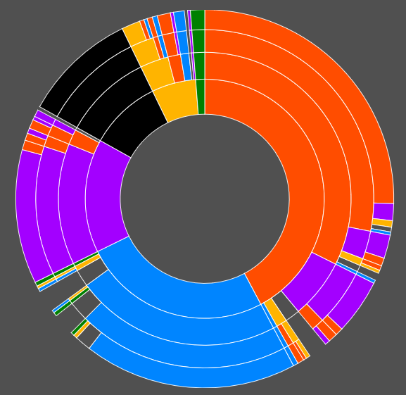
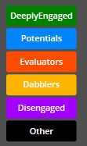
New Customer Path
2%
1%
10%
25%
1%
6%
10%
42%
15%
11%
26%
2%
2%
5%
18%
58% of new customers remain in their initial cluster after 4 months
The most common path to becoming a Deeply Engaged is through Potentials or initially starting as a Deeply Engaged
BACK
*Represents the top 60 new customer paths

Slide 16
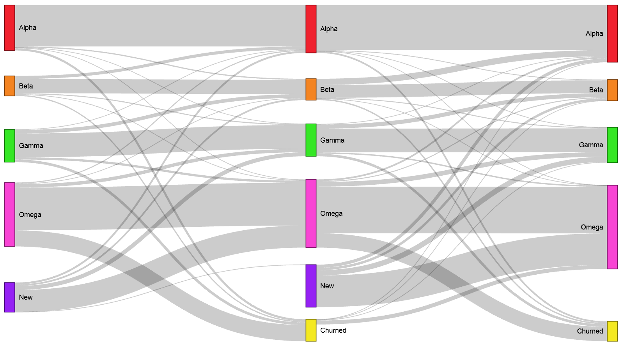
Among Deeply Engaged sub-clusters, 91% of Alpha users remain in the same cluster over 3 months
Jan’15
Feb’15
Mar’15
36% of Beta upgrade to Alpha users in 3 months
Most of the Omega users drop to Evaluators (11%) or Potentials (9%)
Highest churn from Deeply Engaged cluster is observed among Omega cluster (~2%)
BACK

Slide 17
Adopting more and especially premium services are key to upgrade of customers to Deeply Engaged
*
*Change in odds for Churning is 3,900%
Selling a premium service to Potentials doubles the odds of upgrading to Deeply Engaged
For evaluators, increasing # services used doubles the odds of upgrading to Deeply Engaged
Fluctuating behavior in Potential customers leads to their churn
BACK
NEXT

Slide 18
Websites and VM are the most popular pair overall, while Website & SQLDB find wide adoption in all clusters
# 217,122
$ 30.3 M
# 14,643
$ 28.13 M
# 56,395
$ 2.1 M
# 13,125
$ 52.5 K
# 80,753
$ 24.4 K
# 52,206
$ 18
The top 3 common pairs find high adoption in the Deeply Engaged cluster
Websites and SQLDB finds adoption in all clusters while VM & Websites, being more expensive, captures a bigger population in Deeply Engaged customers only
BACK
NEXT
*Utilized revenue contribution to the total UR from the cluster

Slide 19
Deeply Engaged customers are the most important Cloud Services users and drive 84% of its usage
Adoption
Usage
32% of Cloud Services users are Deeply Engaged customers and contribute to 84% of the total Cloud Services usage
21% of the total normalized usage from Deeply Engaged comes from Cloud Services
Deeply Engaged cluster is the only cluster that uses Cloud Services effectively
BACK
NEXT

Slide 20
Upgrading to Deeply Engaged leads to 11x Revenue Lift as Compared to Potentials Engaged
 |  | Final Cluster
 |  | Dabblers | Evaluators | Potentials | Deeply Engaged
Initial Cluster | Potentials | - | - | - | 381
 | Evaluators | - | - | (-) 13 | 368
 | Dabblers | - | 49 | 36 | 417
 | Disengaged | 18 | 67 | 54 | 435
200
 |  | Final Cluster
 |  | Potentials | Deeply Engaged
Initial Cluster | Potentials | - | $189
 | Evaluators | $18 | $207
 | Dabblers
 | Disengaged
20
The most valuable migration is Evaluators/Dabblers/Disengaged → Deeply Engaged ($207)
The next most valuable migration is from Potentials to Deeply Engaged ($189)
BACK
NEXT

Slide 21
Deeply Engaged customers are the major adopters of Premium SKUs
Non-Premium SKUs Adoption & Usage
Premium SKUs Adoption & Usage
2%
1%
1%
0.02%
7%
4%
1%
0.03%
5%
51%
24%
19%
55%
24%
19%
VM
30%
24%
38%
76%
19%
#: 114,094
NU: 19.9 M
4%
5%
#: 11,105
NU: 7.6 M
2%
1%
1%
16%
9%
32%
26%
18%
61%
17%
13%
SQLDB
14%
4%
19%
25%
38%
89%
7%
#: 105,800
NU: 2.4 M
7%
#: 10,674
NU: 2.5 M
4%
6%
15%
9%
37%
26%
13%
33%
7%
Websites
8%
21%
33%
7%
33%
25%
27%
46%
23%
21%
#: 121,130
NU: 0.42 M
#: 26,951
NU: 2.8 M
Population
Usage
Population
Usage
Deeply Engaged
Potentials
Evaluators
Dabblers
Disengaged
Monetizing the Premium usage of BP Customers in Dabblers and Evaluators will help upgrade them to Deeply Engaged
DE customers prefer using Premium VMs while Evaluators prefer using Standard VMs
Having a very low % population using premium SQLDB, DE customers contribute most to the usage. This trend can be seen in many other services too
BACK
NEXT
*VM – Non-Premium: A1-A4, Premium: A5-A9 and all D Series SQLDB – Non-Premium: Web Edition, Basic and Standard, Premium: Premium, Business Editions Websites – Non-Premium: Free and Shared, Premium: Basic and Standard

Slide 22
Virtual Network and Traffic Manager act as enabler service for both Deeply Engaged and Potentials
# Users
556
1,235
1,280
639
# Users
98
852
336
206
Adopters (Deeply Engaged) of Virtual Network result in an increase in overall usage by 114 units and Utilized Revenue by $67
BACK
More…

Slide 23
Feature Selection
Engagement = f {Breadth, Depth, Usage Pattern}
Depth of usage
Breadth of usage
Pattern of usage
# of Services
Normalized Units
% Non-Billable Usage
#of Projects
Utilized Revenue
Step Count
*Click on the boxes for more info

Slide 24
Azure revenue is driven by Deeply Engaged and Potentials
Deeply Engaged
Potentials
Evaluators
Usage
Dabblers
Disengaged
Revenue
81% of the Azure active population spends <$15 a month
Deeply Engaged and Potentials (33% of the population) generate 99% of the revenue
Dabblers are the only other cluster that contribute to Azure revenue apart from these, Evaluators delve in free usage whereas Disengaged customers are essentially inactive
BACK
NEXT

Slide 25
How does the breadth of service vary across clusters?
Service Count Distribution Across clusters
# Services | Deeply Engaged | Potentials | Evaluators | Dabblers | Disengaged
1 | 0% | 15% | 0% | 0% | 54%
2 | 0% | 14% | 1% | 11% | 36%
3 | 0% | 30% | 46% | 40% | 10%
4 | 0% | 25% | 28% | 25% | 0.0%
5 | 3% | 16% | 16% | 13% | 0.0%
6 | 35% | 0% | 6% | 6% | 0.0%
7 | 21% | 0% | 3% | 3% | 0.0%
8 | 19% | 0% | 0% | 1% | 0.0%
9 | 10% | 0% | 0% | 0% | 0.0%
10 | 5% | 0% | 0% | 0% | 0.0%
11 | 3% | 0% | 0% | 0% | 0.0%
12 | 2% | 0% | 0% | 0% | 0.0%
13 | 1% | 0% | 0% | 0% | 0.0%
14 | 1% | 0% | 0% | 0% | 0.0%
Deeply Engaged customers have the highest breadth of services with 97% using 6 or more services.
Majority of Potentials (55%), Evaluators (74%) and Dabblers (65%) use 3 to 4 services
~90% of Evaluators and Dabblers use at least 3 services whereas that amounts to ~70% for Potentials
Effect of Workload count

Slide 26
How does the service count vary across clusters?
Service Adoption within clusters
Service | Deeply Engaged | Potentials | Evaluators | Dabblers | Disengaged | Active
Storage | 99% | 71% | 92% | 64% | 68% | 79%
Bandwidth- Data Transfer | 99% | 76% | 97% | 99% | 6% | 70%
Websites | 84% | 41% | 46% | 72% | 31% | 45%
Virtual Machines | 75% | 40% | 72% | 32% | 4% | 45%
SQLDB | 87% | 44% | 36% | 60% | 33% | 42%
Cloud Services | 54% | 12% | 10% | 3% | 2% | 11%
Mobile Services | 32% | 3% | 9% | 12% | 4% | 8%
Virtual Network | 31% | 8% | 5% | 4% | 2% | 7%
Service Bus | 39% | 2% | 5% | 8% | 2% | 6%
Notification Hubs | 28% | 1% | 6% | 9% | 1% | 5%
Normalized Usage Share within clusters
Service | Deeply Engaged | Potentials | Evaluators | Dabblers | Disengaged | Active
Storage | 6% | 7% | 5% | 8% | 21% | 6%
Bandwidth- Data Transfer | 2% | 3% | 1% | 0% | 0.29% | 2%
Websites | 3% | 6% | 8% | 18% | 20% | 5%
Virtual Machines | 52% | 65% | 72% | 47% | 17% | 56%
SQLDB | 8% | 4% | 4% | 13% | 17% | 7%
Cloud Services | 21% | 9% | 7% | 3% | 13% | 17%
Mobile Services | 0.06% | 0.03% | 0.06% | 1% | 0.06% | 0.06%
Virtual Network | 1% | 1% | 1% | 1% | 4% | 1%
Service Bus | 0.23% | 0.11% | 0.30% | 1% | 1% | 0.23%
Notification Hubs | 0.02% | 0.01% | 0.01% | 0.11% | 0.07% | 0.02%
Athough Virtual Machines have a comparatively lower adoption, their usage is the highest across clusters
Cloud Services adoption is highest for Deeply Engaged customers and accounts for 21% of total usage
Usage across all clusters

Slide 27
Cluster Profiles
* % of EA customers in the particular category
** Lowest % customers contributing to 80% of usage
*** % Represents customers with >=1 Premium Services. All Services except Compute, Storage and Bandwidth are considered as Premium Services
**** % of Customers who have multiple offer types in Dec
BACK

Slide 28
PaaS users exhibit lesser churn as compared to IaaS users
# Users
2,385
5,564
5,463
1,197
13%-15% IaaS only users discontinue their usage every month as compared to 7%-9% for PaaS
A higher proportion (~80%) of PaaS users have been in Azure for more than a year
BACK
*Deeply Engaged customers in December is the population considered here
**Usage churn is the ratio of customers discontinuing usage in a month to the number of customers using in the previous month

Slide 29
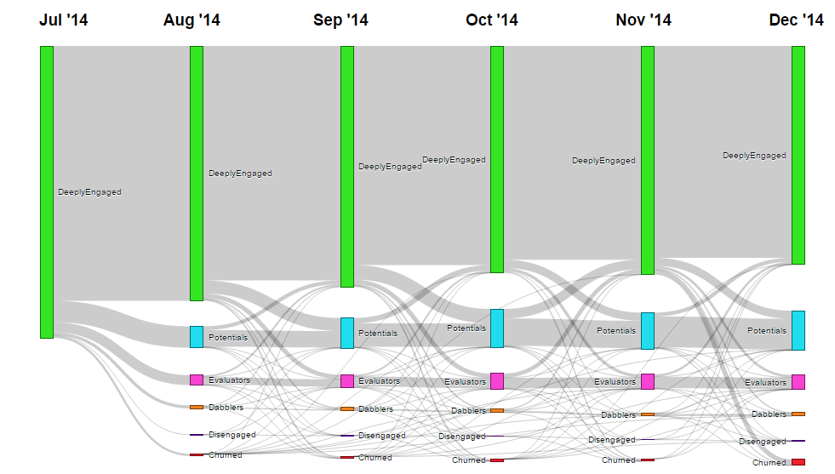
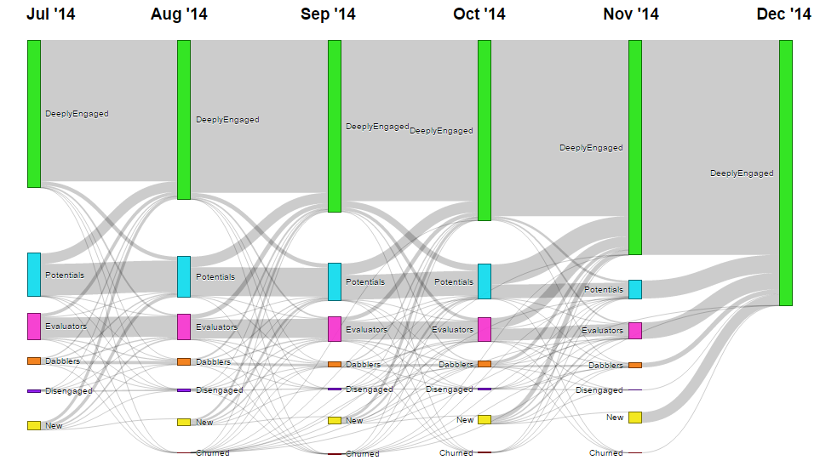
Migration Path of Deeply Engaged
Deeply Engaged (Jul’14): Transitions over next 6 months
Deeply Engaged (Dec’14): Transitions in prior 6 months
 | End # | End %
Deeply Engaged | 8,151 | 75%
Potentials | 1,472 | 14%
Evaluators | 547 | 5%
Dabblers | 151 | 1%
Disengaged | 40 | 0%
Churned | 521 | 5%
 | Start # | Start %
DeeplyEngaged | 8,151 | 56%
Potentials | 2,384 | 16%
Evaluators | 1,444 | 10%
Dabblers | 384 | 3%
Disengaged | 115 | 1%
New | 2,183 | 15%
14% of Deeply Engaged drop to potentials over 6 months and 5% churn out of the system
Potentials (16%) followed by New acquisitions (15%) and Evaluators (10%) are the key sources of origin for Deeply Engaged

Slide 30
Visual Studio acts as an enabler service for both Evaluators and Disengaged
# Users
556
1,235
639
# Users
15
Adoption of BizTalk Services by Evaluators result in a change in Normalized Usage by 24 units but has no effect on Utilized Revenue
Visual Studio is the only service in Disengaged which enhances Normalized Usage and Utilized Revenue
BACK

Slide 31
Normalized Usage and Utilized Revenue
Normalized Usage
Usage multiplied by charge amount at PAYG rates summed over a calendar month
Utilized Revenue
It is normalized usage minus the free credits summed around the anniversary dates
Customer | Service | Units | Duration | Price | Normalized Usage
C1 | Virtual machine (A0) | 5 Compute Hours | 5 Hours | $0.02/Hour | 5*0.02 = 0.1
 | Mobile services (Basic) | 1 unit | 1 month | $ 14.99/month | 1*14.99=14.99
 | SQLDB (S2) | 1 unit | 10 Hours | $0.1008/Hour | 10*0.1008= 1.008
Total |  |  |  |  | 16.098
BACK

Slide 32
Appendix – Extra Slides

Slide 33
Azure revenue is driven by Deeply Engaged and Potentials
Deeply Engaged
Potentials
Dabblers
Usage
Evaluators
Disengaged
Revenue
Deeply Engaged and Potentials (33% of the population) generate 99% of the revenue
Dabblers are the only other cluster that contribute to Azure revenue apart from these
Evaluators delve in free usage whereas Disengaged customers are essentially inactive
BACK

Slide 34
Adopting more and especially premium services are key to upgrade of customers to Deeply Engaged
Selling a premium service to Potentials doubles the odds of upgrading to Deeply Engaged
For evaluators, increasing # services used doubles the odds of upgrading to Deeply Engaged
Apart from Deeply Engaged, BP customer heavy clusters Evaluators and Dabblers use premium SKUs – Monetizing their usage of these will help upgrade them to Deeply Engaged
BACK

Slide 35
Cross Sell of Virtual Network to Deeply Engaged Virtual Machine users result in a gain of 80 NU per customer
Deeply Engaged
Potentials
{Virtual Network}=>{Virtual Machines}
Evaluators
{Website}=>{SQLDB}
{Traffic Manager}=>{Virtual Network}
{Cache}=>{SQLDB}
{Mobile Services}=>{Website}
{Cloud Services}=>{Service Bus}
{Cloud Services}=>{SQLDB}
****revise****The opportunities for cross sell are different across clusters
Virtual Network is the key service in Deeply Engaged and SQLDB in Potentials, showing a clear distinction in the flavors of services used by them
BACK
NEXT

Slide 36
Azure customers portray 5 distinct clusters based on their engagement behavior
Deeply Engaged
Potentials
Evaluators
Dabblers
Disengaged
66%
Normalized Usage
19%
Normalized Usage
13%
Normalized Usage
1%
Normalized Usage
1%
Normalized Usage
Highlights:
Contribute 77%
of Azure revenue
18% of these are EA
…Add one more point
Highlights:
Contribute 22%
of Azure revenue
75% are PAYG
…Add one more point
Highlights:
Contribute 0%
of Azure revenue
90% are BP
…Add one more point
Highlights:
Contribute 0%
of Azure revenue
High Migration
to Potentials
…Add one more point
Highlights:
Contribute 0%
of Azure revenue
High Migration to and from Evaluators
…Add one more point

Slide 37

Executive Summary
Revenue Skew
99% of the revenue is generated by Deeply Engaged and Potentials, who constitute 33% of the population
Service Usage Patterns
SQLDB and Websites is the most commonly used pair across all clusters
21% of total usage of Deeply Engaged customers’ comes from Cloud Services
Cluster Migration & Upgrade
Upgrade to Deeply Engaged leads to 11X lift in revenue to Azure as compared to upgrade to Potentials
Dabblers most commonly upgrade to Potentials by increasing frequency and stabilizing their usage
Cross-sell of premium services is the key to upward migration to Deeply Engaged
Opportunities for increasing customer engagement
Selling Virtual Network to customers using Virtual Machines results in a gain of 80 NU* per customer
There is a scope for up-sell and cross-sell of Premium SKUs to Deeply Engaged customers

Slide 38
Next Steps
Recommendation Engine
Building a recommendation engine at a cluster level to recommend feasible services to customers
Retention Modelling and Experimentation
Experimentation with controlled service offerings to customers in order to deepen insights into customer behavior and reduce churn
Customer Nurturing & Sales
Cluster lifetime customer behavior can be leveraged to identify the right time for intervention by marketing and sales teams
Pricing?
Cluster usage behavior can be

Slide 39
Next Steps
Recommendation Engine
Retention Modelling and Experimentation
Customer Nurturing & Sales
Usage Based Pricing
Building a recommendation engine at a cluster level to recommend feasible services to customers
Experimentation with controlled service offerings to customers in order to deepen insights into customer behavior and reduce churn
Cluster lifetime customer behavior can be leveraged to identify the right time for intervention by marketing and sales teams
Cluster usage behavior can be used to devise discount bands based on usage

